Slide 1
Thank you for trusting DLI with your business and your lawn…
Today we will learn more about the bid process and go over your customized sprinkler system!
$0
DOWN!

Slide 2
First we must contact Dig Safe and have the lawn marked for lines such as gas and cable. This takes at least 3 days.
Within 2 weeks Dreier’s will begin marking your system with our flags! How will you know the difference? Ours are clearly marked and pink!

Slide 3
FREEZE RESISTANT polyurethane pipe
We will install the heads without tearing up your lawn
All lines are placed 8 inches deep, missing all other lines! (Cable line shown unscathed)
Grass will be laid back over the piping leaving no trenches

Slide 4
1 DAY AFTER
2 WEEKS AFTER
1 MONTH AFTER
In a little over a month you will never know we were there!

Slide 5
Our pressure drains do not need blown out and can be turned off and on all year around!
What an installed drain looks like…this design is meant to give or break in a particular spot saving you extra CASH $ … ASK HOW?
MPR Rotor heads provide better coverage and is more efficient per zone

Slide 6
We always use the best priced and most durable valves
We will teach you how to set your controller
Valves are installed under ground so the wires are protected. These can be easily found with the map and a locater
We lay extra wiring and provide space for up to 22 zones so adding them later is easy and less costly

Slide 7
CITY WATER WINTERIZATION
Shut off main valve
Go to PVB and turn 2 test port valves with a screw driver ¼ turn either way
Return to drain valve and open
Go back to PVB and close test port valves
WELL WATER WINTERIZATION
Locate the filter on well
Open red nozzle as shown
Water will drizzle out into clear casing
Ready for winter
Our CERTIFIED backflow system will protect your drinking water and makes winterizing a breeze!

Slide 8
Get a tower to use for flowerbeds
These drip pipes are perfect for trees and shrubs

Slide 9
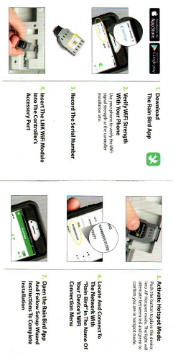
A rain sensor takes the guess work out of watering…
v
OR
Make it mobile friendly and conveniently manage your system completely online !!!

Slide 10
Don’t forget to check out all our great services @ DreiersLawn.com

